Slide 1
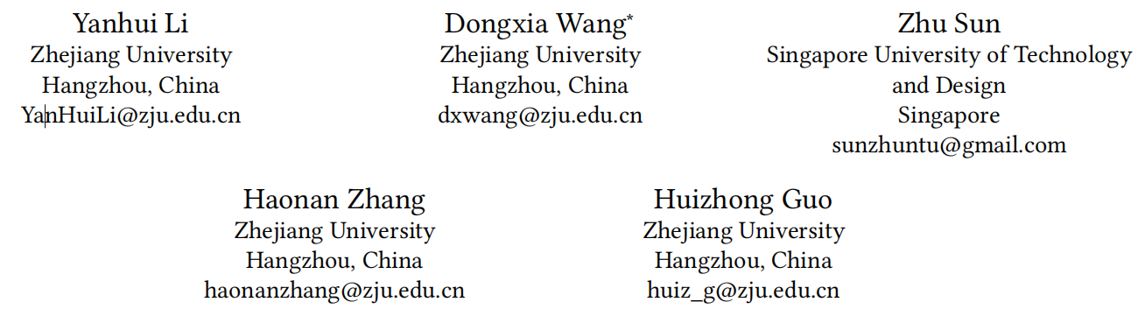





LightKG: Efficient Knowledge-Aware Recommendations with Simplified GNN Architecture
（KDD-2025 code: https://github.com/1371149/LightKG)
Reported by Jiale Shen

Slide 2
motivation
(1)Building upon GNN based KGRSs, Self-Supervised Learning (SSL) has been incorporated to address the sparity issue, leading to longer training time.
(2)More complex models tend to perform worse in sparse interaction scenarios and complex mechanisms, like attention mechanism, can be detrimental as they often increase learning difficulty.

Slide 3
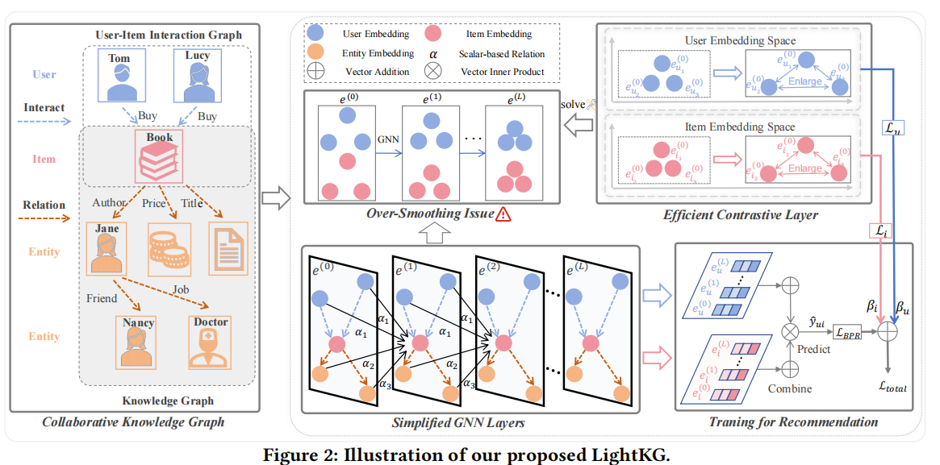
Overview

Slide 4
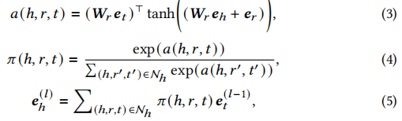

Approach

Slide 5
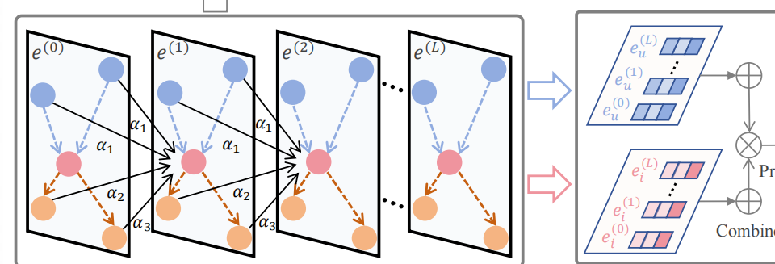

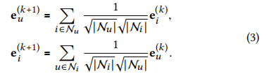
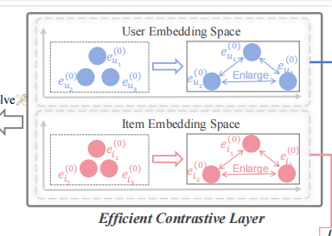





Approach
LightGCN

Slide 6
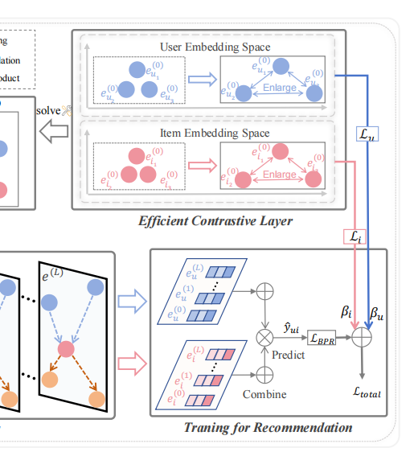


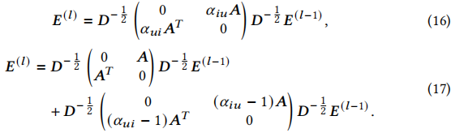
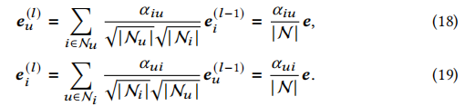
Approach

Slide 7
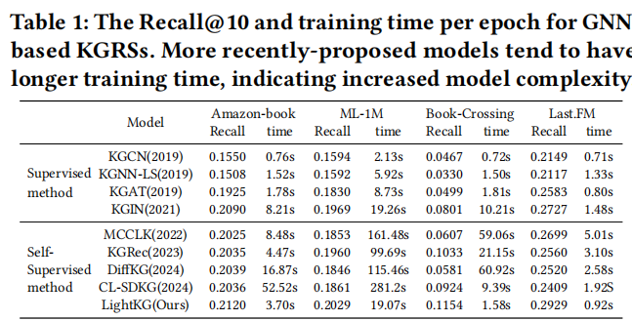
Experiment

Slide 8
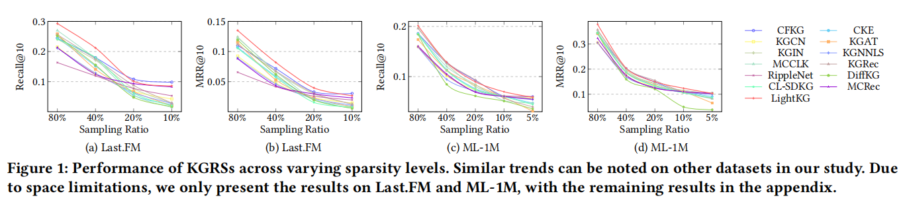
Experiment

Slide 9
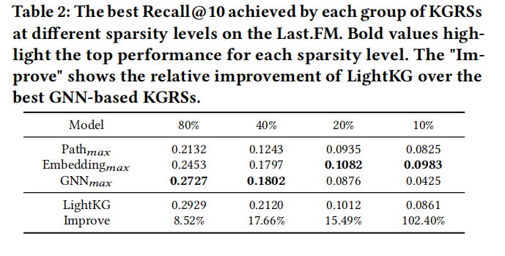
Experiment

Slide 10
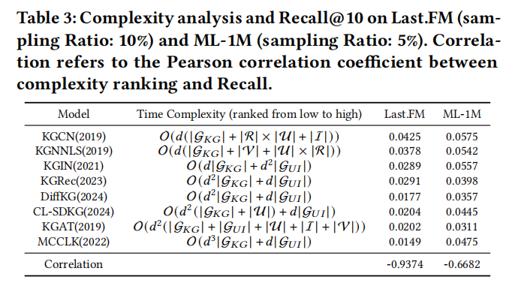
Experiment

Slide 11
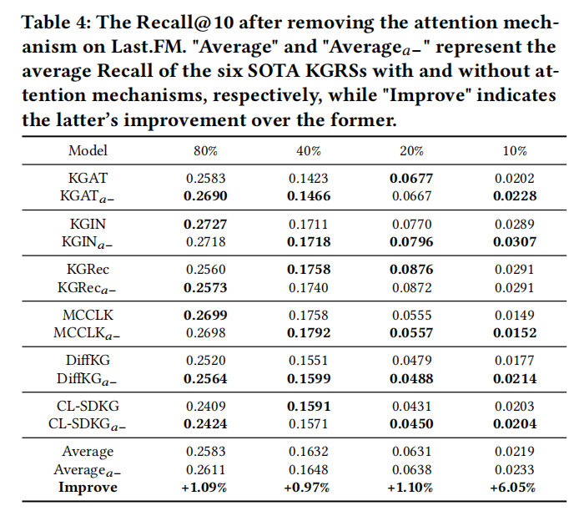
Experiment

Slide 12
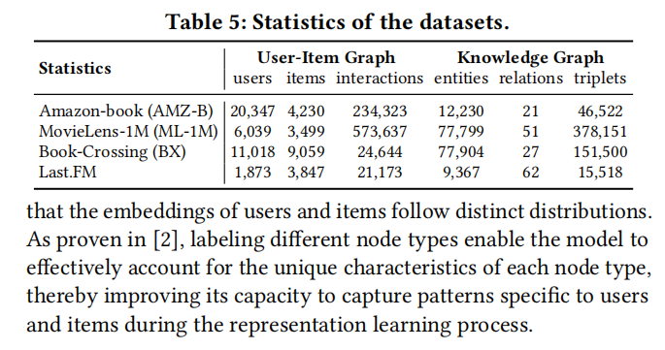
Experiment

Slide 13
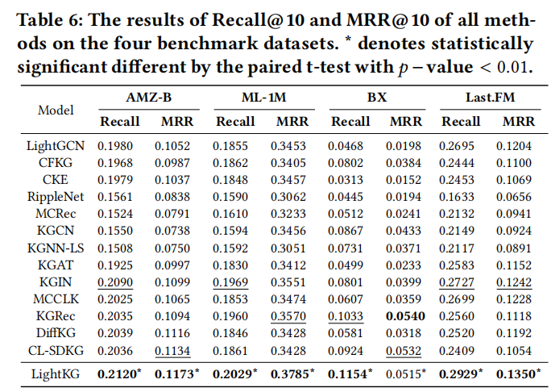
Experiment

Slide 14
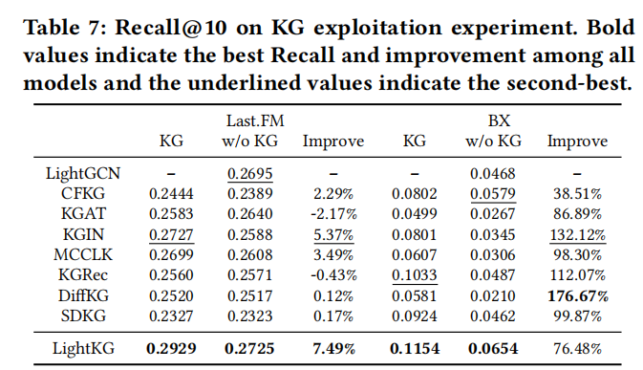
Experiment

Slide 15
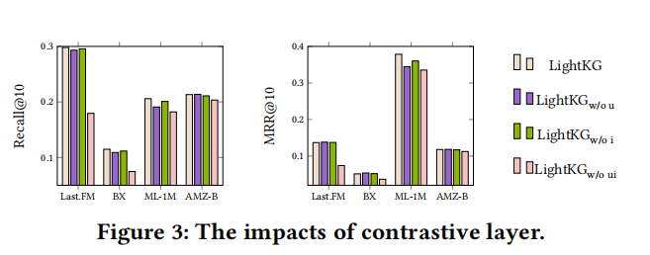
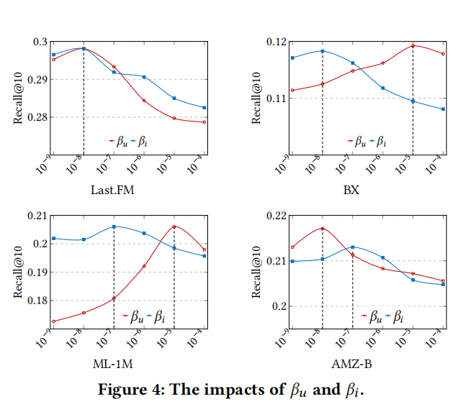
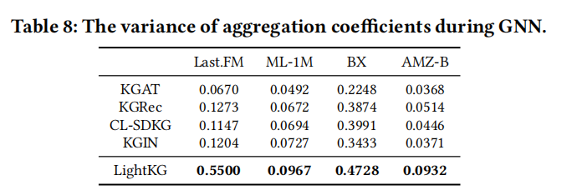
Experiment

Slide 16
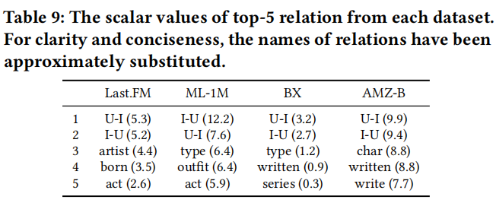
Experiment

Slide 17
Thank you!

